Slide 1



Team Members
CITIL’S SDG Hackathon ‘25
Problem Statement ID : CIT 04
Problem Statement : Design an Eco-Friendly Resource Management Platform for monitoring water and electricity usage,
reducing the campus carbon footprint, and promoting sustainability
Team Name : IMPULSE
Member 1 - Reg No - Name- Dept
Member 2 - Reg No - Name- Dept
Member 3 - Reg No - Name- Dept
Member 4 - Reg No - Name- Dept
Member 5 - Reg No - Name- Dept

Slide 2
IDEA / SOLUTION
Proposed Solution
(Describe your Idea/Solution/Prototype)
Detailed explanation of the proposed solution
IoT-Based Data Collection: Smart sensors track energy, water, occupancy, and waste in real-time.
AI-Driven Decision-Making: Neuro-symbolic AI and Swarm Intelligence optimize resource distribution.
How it addresses the problem
Optimized Resource Utilization: AI dynamically adjusts HVAC, lighting, and water systems based on demand.
Energy Efficiency & Sustainability: Reduces energy consumption by up to 40% using smart scheduling.
Innovation and uniqueness of the solution :
AI-Driven Self-Healing Infrastructure: Uses predictive maintenance and automated fault detection to prevent failures before they occur.
AI-Driven Self-Healing Infrastructure: Uses predictive maintenance and automated fault detection to prevent failures before they occur.
Blockchain-Based Sustainability Rewards: Tracks resource usage transparently and incentivizes eco-friendly behavior with green credits.
Neuro-Symbolic AI: Combines deep learning with symbolic reasoning for smarter decision-making.

Slide 3
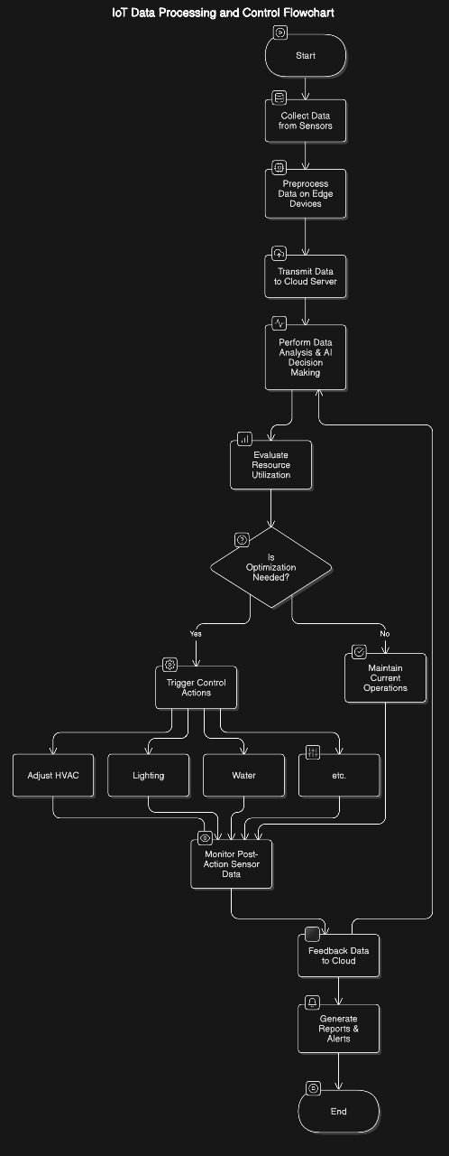
TECHNICAL APPROACH
Methodology and process for implementation

Slide 4
FEASIBILITY AND VIABILITY
Analysis of the feasibility of the idea
Technical Feasibility: Uses existing AI, IoT, and blockchain technologies for seamless integration.
Economic Feasibility: Expected to reduce energy costs by up to 40%, ensuring high ROI.
Operational Feasibility: Automates infrastructure management, reducing manual intervention
Potential challenges and risks
High Initial Investment: Requires funding for IoT sensors, AI models, and blockchain infrastructure.
Data Security Risks: Ensuring cybersecurity and privacy protection for campus resource data.
Integration Complexity: Merging AI, IoT, and existing systems without disrupting operations.
Strategies for overcoming these challenges
Cost Optimization: Start with a small-scale prototype and gradually expand based on ROI.
Enhanced Security: Implement end-to-end encryption and blockchain for secure data handling.
Seamless Integration: Use modular architecture and APIs to ensure compatibility with existing systems.

Slide 5
IMPACT AND BENEFITS
Potential impact on the target audience
Improved Efficiency: Enhances campus operations by reducing energy waste and optimizing resources.
Cost Savings: Lowers utility expenses by up to 40%, benefiting administrators and facility managers.
Sustainability Awareness: Encourages students and staff to adopt eco-friendly practices through incentives.
Benefits of the solution
Energy & Cost Savings: Reduces energy consumption by up to 40%, lowering operational costs.
Automated Maintenance: Predictive AI prevents failures, extending equipment lifespan by 20%.
Sustainability Impact: Promotes green energy use, reducing carbon footprint and waste.

Slide 6
Conclusion
Optimized Resource Utilization: AI-driven automation reduces energy and water waste efficiently.
Cost & Energy Savings: Lowers operational expenses by up to 40% while enhancing sustainability.
Predictive Maintenance: Self-healing infrastructure prevents failures and extends equipment lifespan.
Blockchain-Based Transparency: Ensures secure, transparent tracking of resource consumption and incentives.
Scalability & Future Readiness: Can be expanded to smart cities, industries, and large-scale infrastructures.

